Slide 1

CSC492H5 Web Design: Strategy and Information Architecture
Notes:
Course 3: Web Design: Strategy and Information Architecture
I’ll hold off on my comments on this course til the end.
Questions from Petersen:
When creating profiles, REALLY think about making them different. Think about accessibility, think about genders, think about different usecases.

Slide 2
Week 1: The UX Process
Topics covered:
UX Process Outline
User-Centric Design
Websites vs Apps
Next Steps
Notes:
Week 1
We again defined User Experience with some examples of roles in the industry. We outlined a typical approach to UX design, some pros and cons of waterfall vs agile approach and websites vs apps.

Slide 3
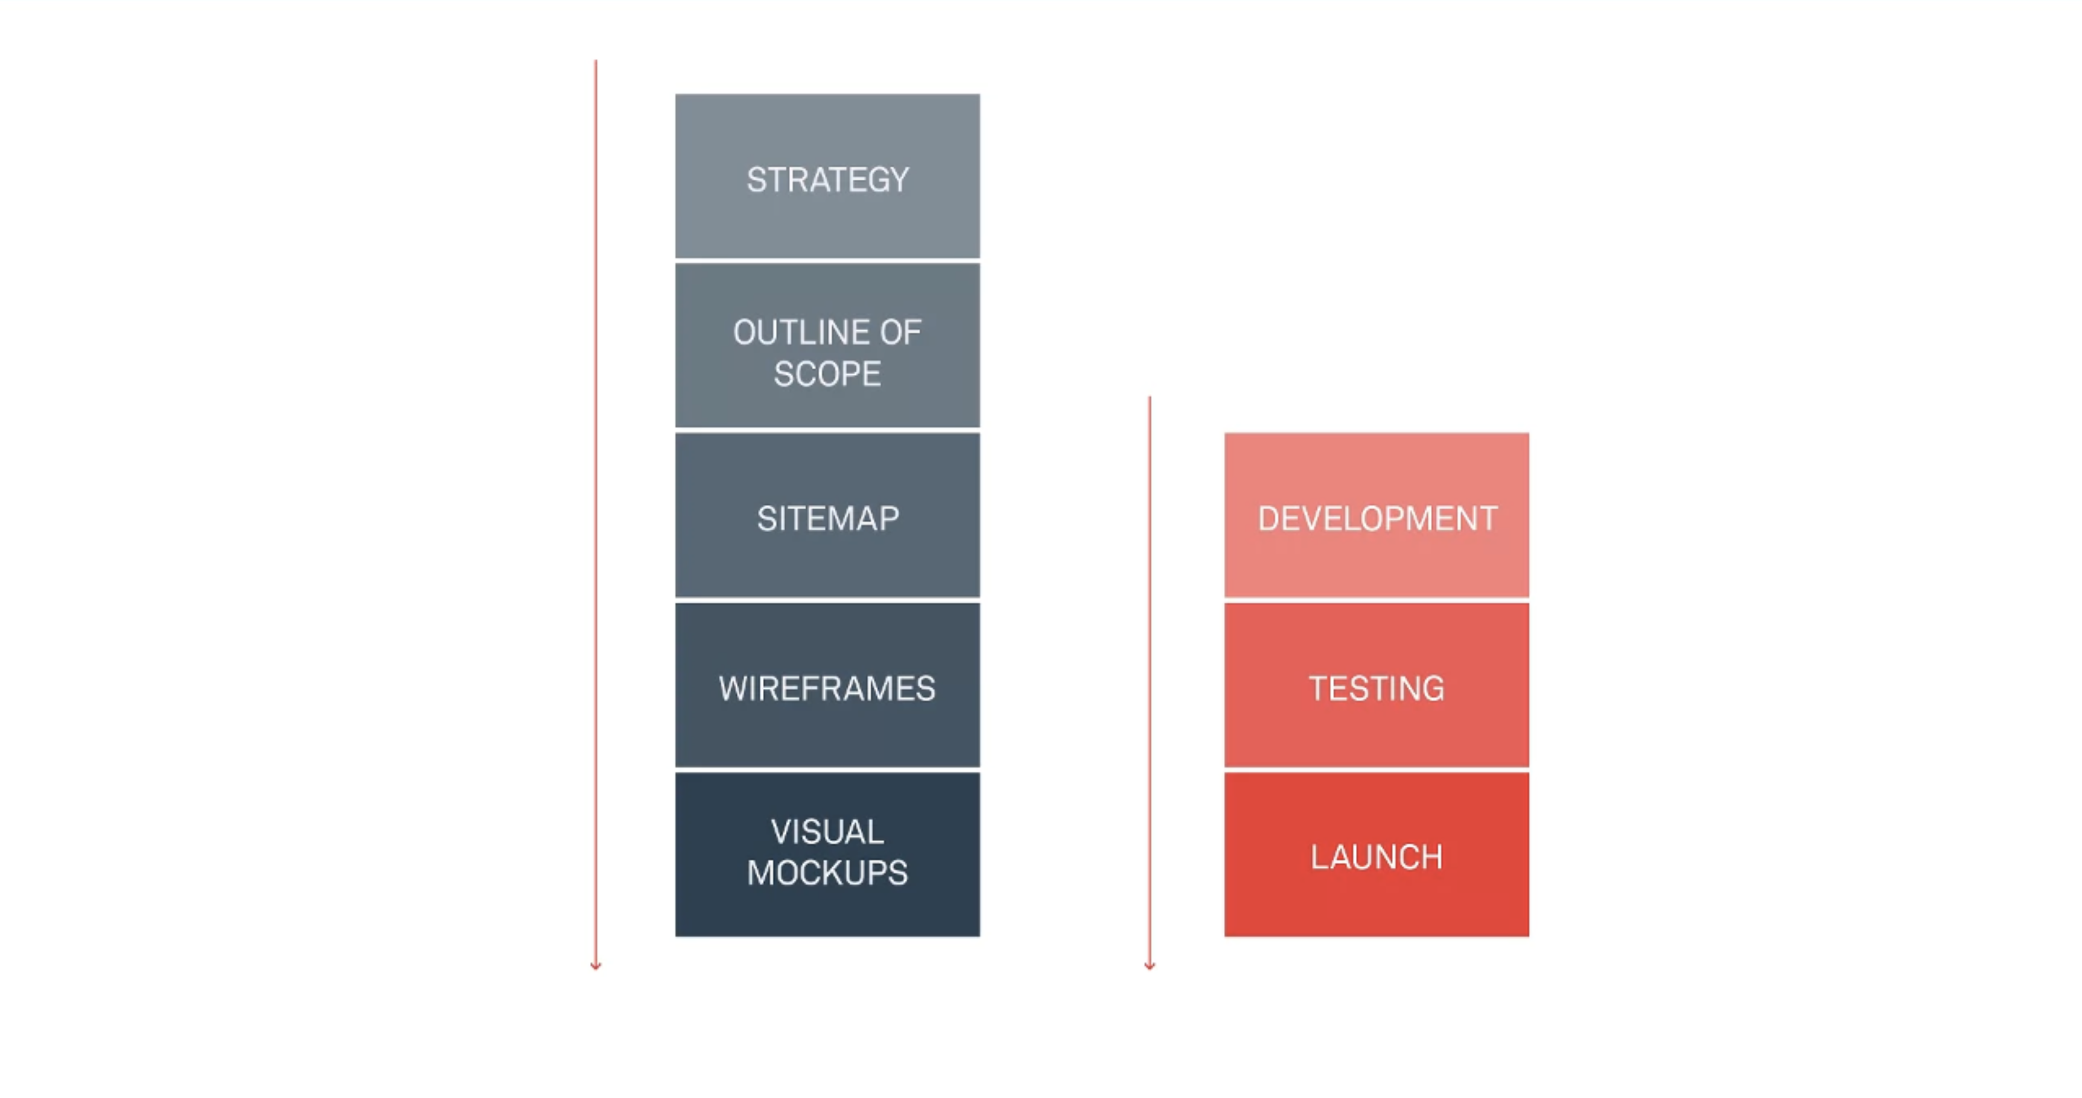
Notes:
Outline of the UX process includes: Strategy -> Outline of Scope -> Sitemap -> Wireframes -> Visual Mockups.
These phases start off abstract and gradually become more and more concrete.
Initially, we’re not too concerned with the final shape of the site. And by the visual mockup phase, that’s our main focus.
This process often follows a waterfall approach with each phase being agile.
This makes sense because you want the flexibility of modifying changes at each step, you don’t want the project to take years before finally releasing even an MVP.
In short, and I’ve heard this phrase thrown around often – “fail fast and fail hard”.
Then the next steps would be the actual coding of the product. This includes Development -> Testing -> Launch.
This is most often done in an agile approach.
Entering this phase marks a large step in investment – Both in time, and often money.

Slide 4
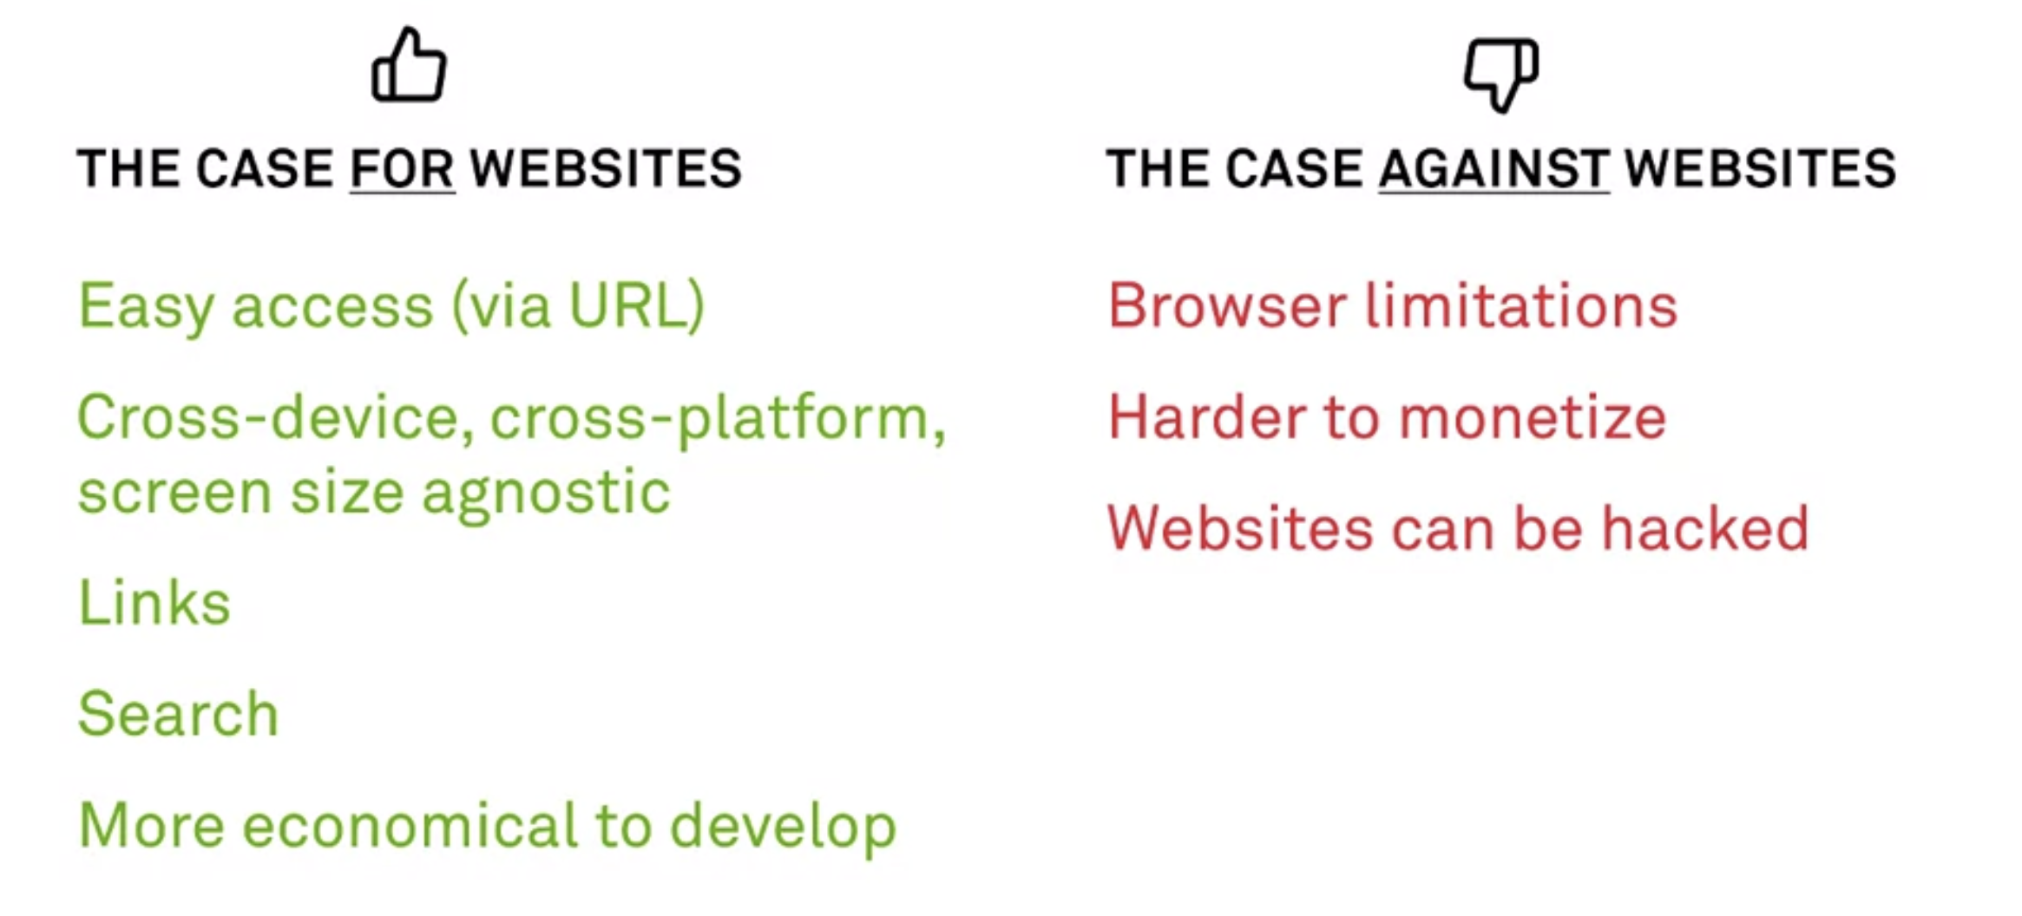
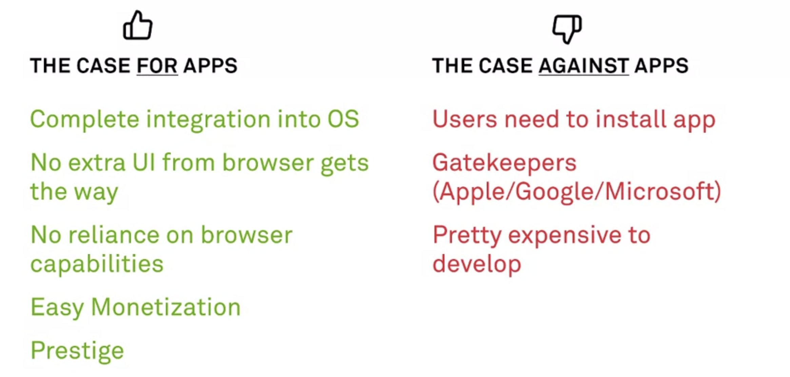
Notes:
We then discussed the pros and cons of websites vs apps.
Many of these are already well known for us in computer science, so I won’t go over them.
This is also why we figured Nox would be best suited as a website as opposed to an app.
Focal point was ease of use and rapid development especially considering we don’t need any special access to OS level functionality.

Slide 5

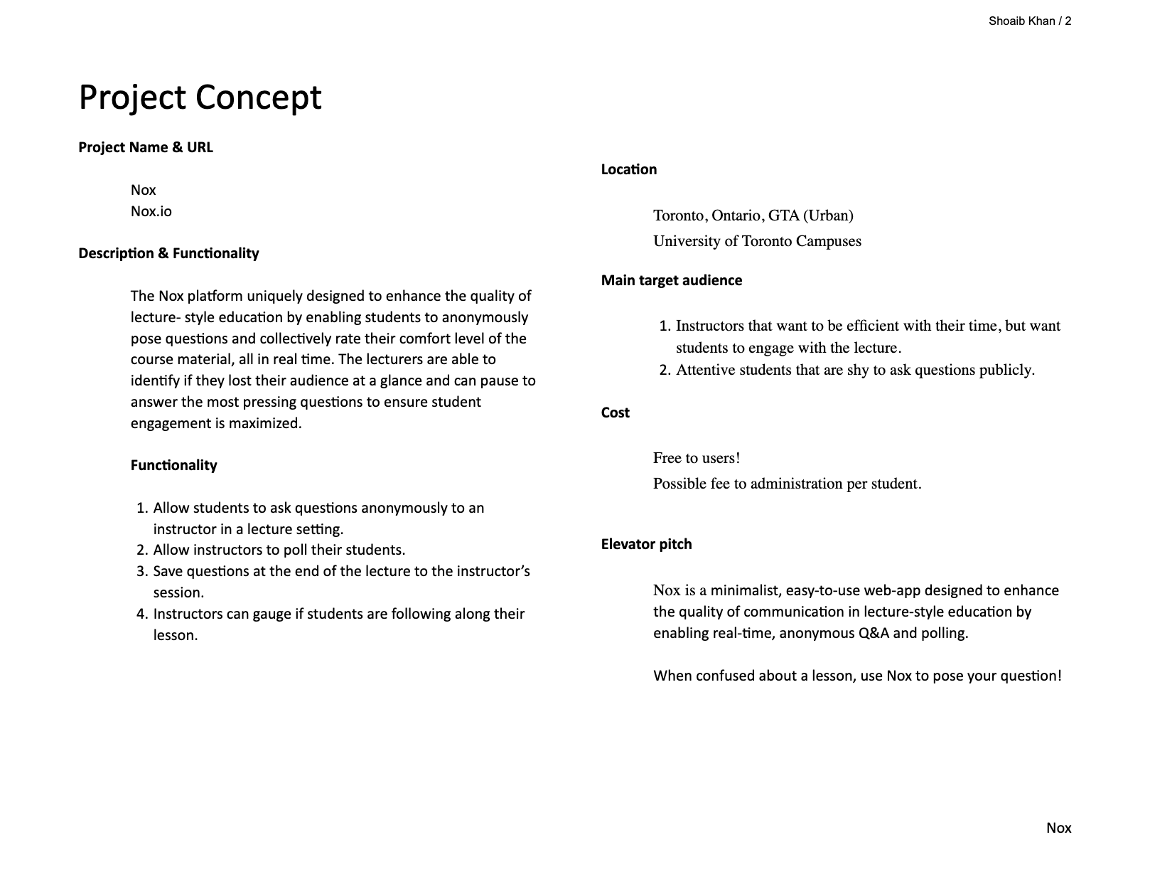
Notes:
This was the week 1 deliverable. This is part 1 of our Strategy document.
It was basically revisiting and refining our project brief from the previous course.

Slide 6
Week 2: Determining Strategy
Topics covered:
Research
User Research, Inspiration, Analytics
Needs
User and Client Needs
Audiences
Target Audience
Roles, Demo/Psychographics, …
User Personas
Notes:
This week was all about doing research on our audience and laying out their needs and the needs of the client.
This, again was mainly revisiting the project brief from the previous course, refining, then building on top of it.

Slide 7
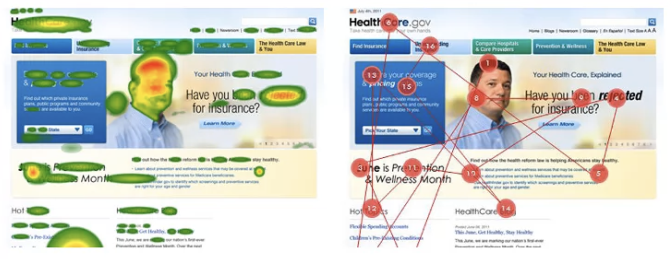
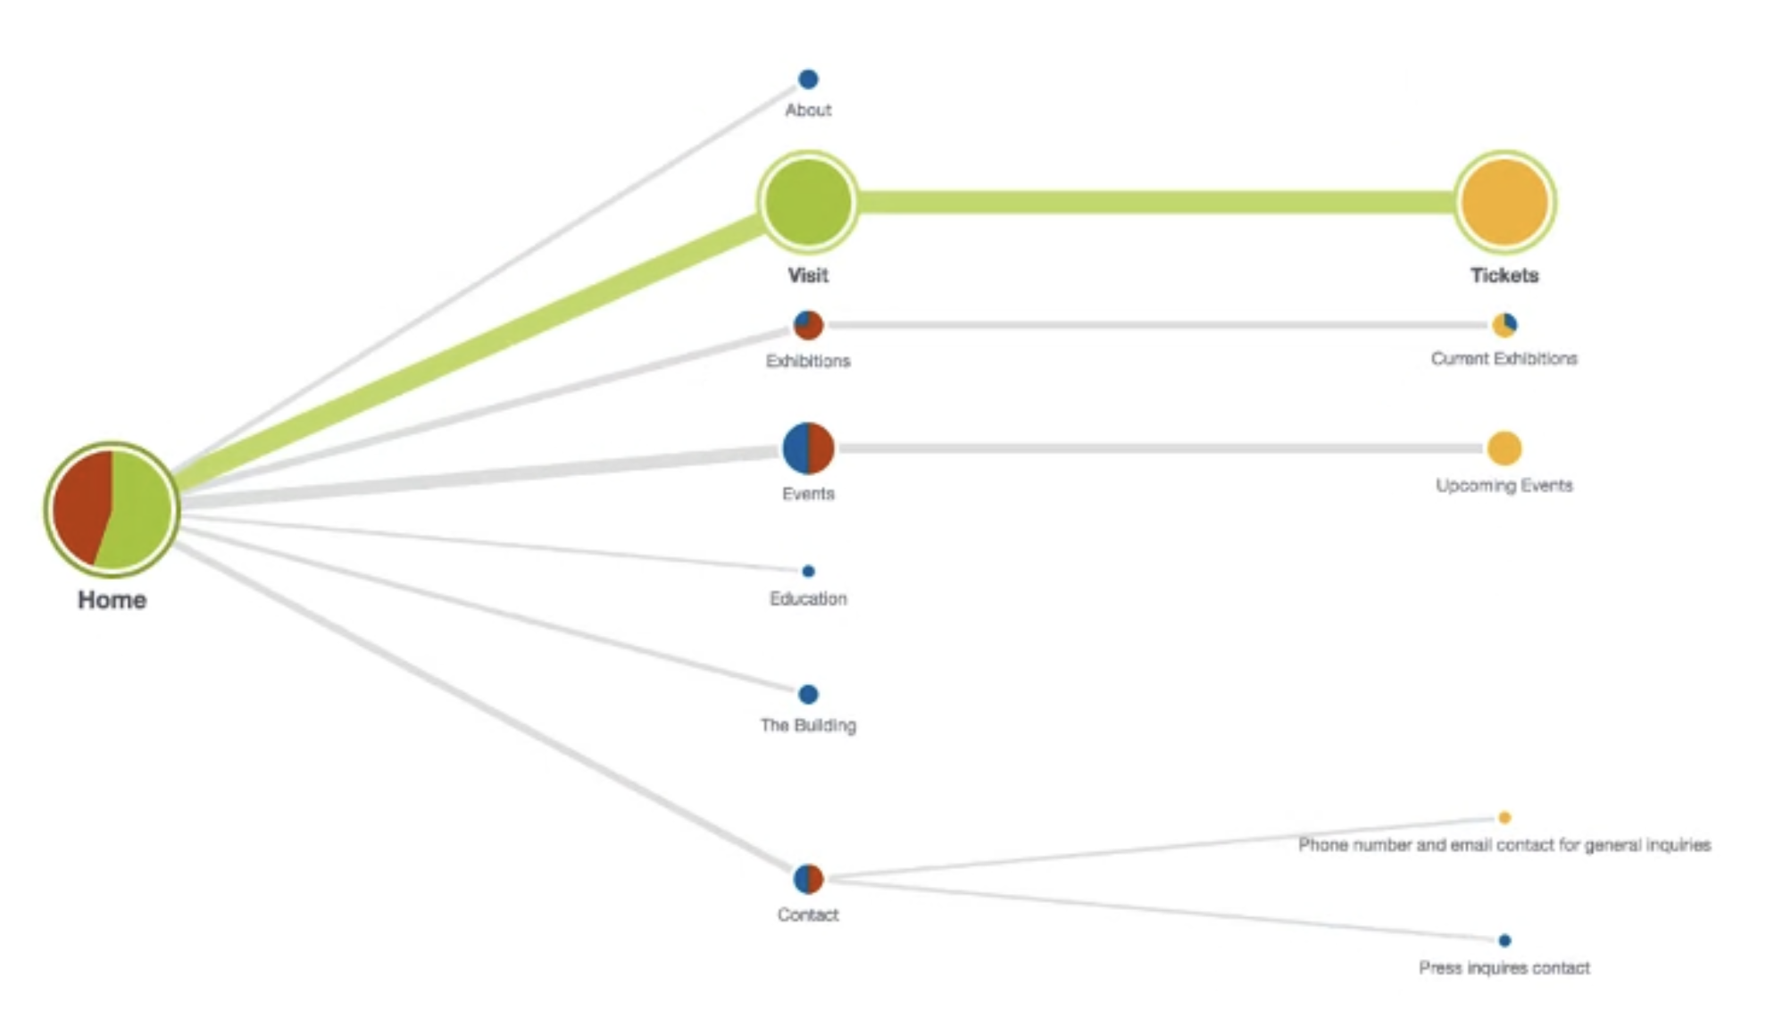
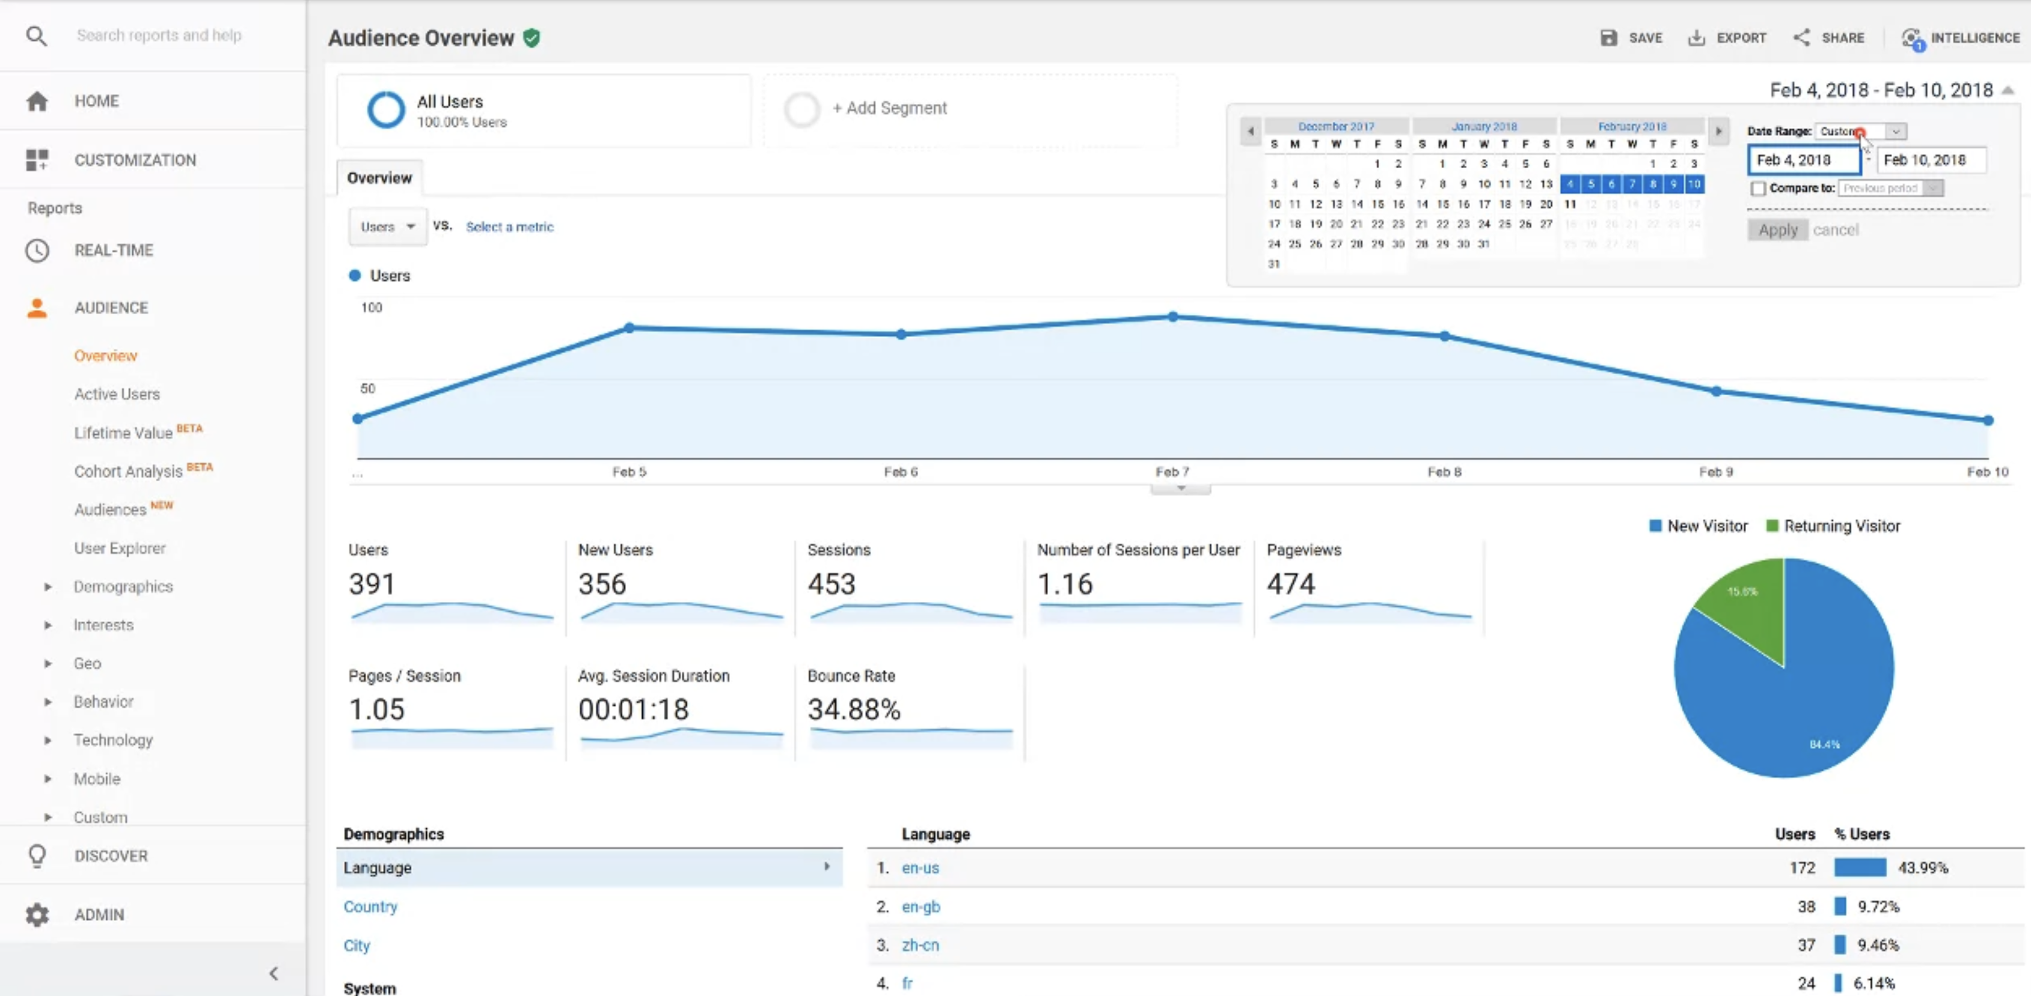
Notes:
Some user research discussed included eye tracking experiments. Heat map and pathway tracking examples above. This is often quite costly though.
There was a cool tool called TreeJack that allows you to test the intuitiveness of your navigation.
Are your users able to access content or perform a function easily? Can isolate functions and contents to address.
And they have a generous free tier.
Also discussed analytics tools such as Google Analytics which can be used to gain TONS of insight on viewership and make decisions accordingly.
You can ask questions like: How many users are mobile users? → And decide whether you should allocate resources to improving that experience?
Did any of our ad campaigns or referrals work → Depending on how effective they were, you can know where to spend marketing efforts in the future.

Slide 8
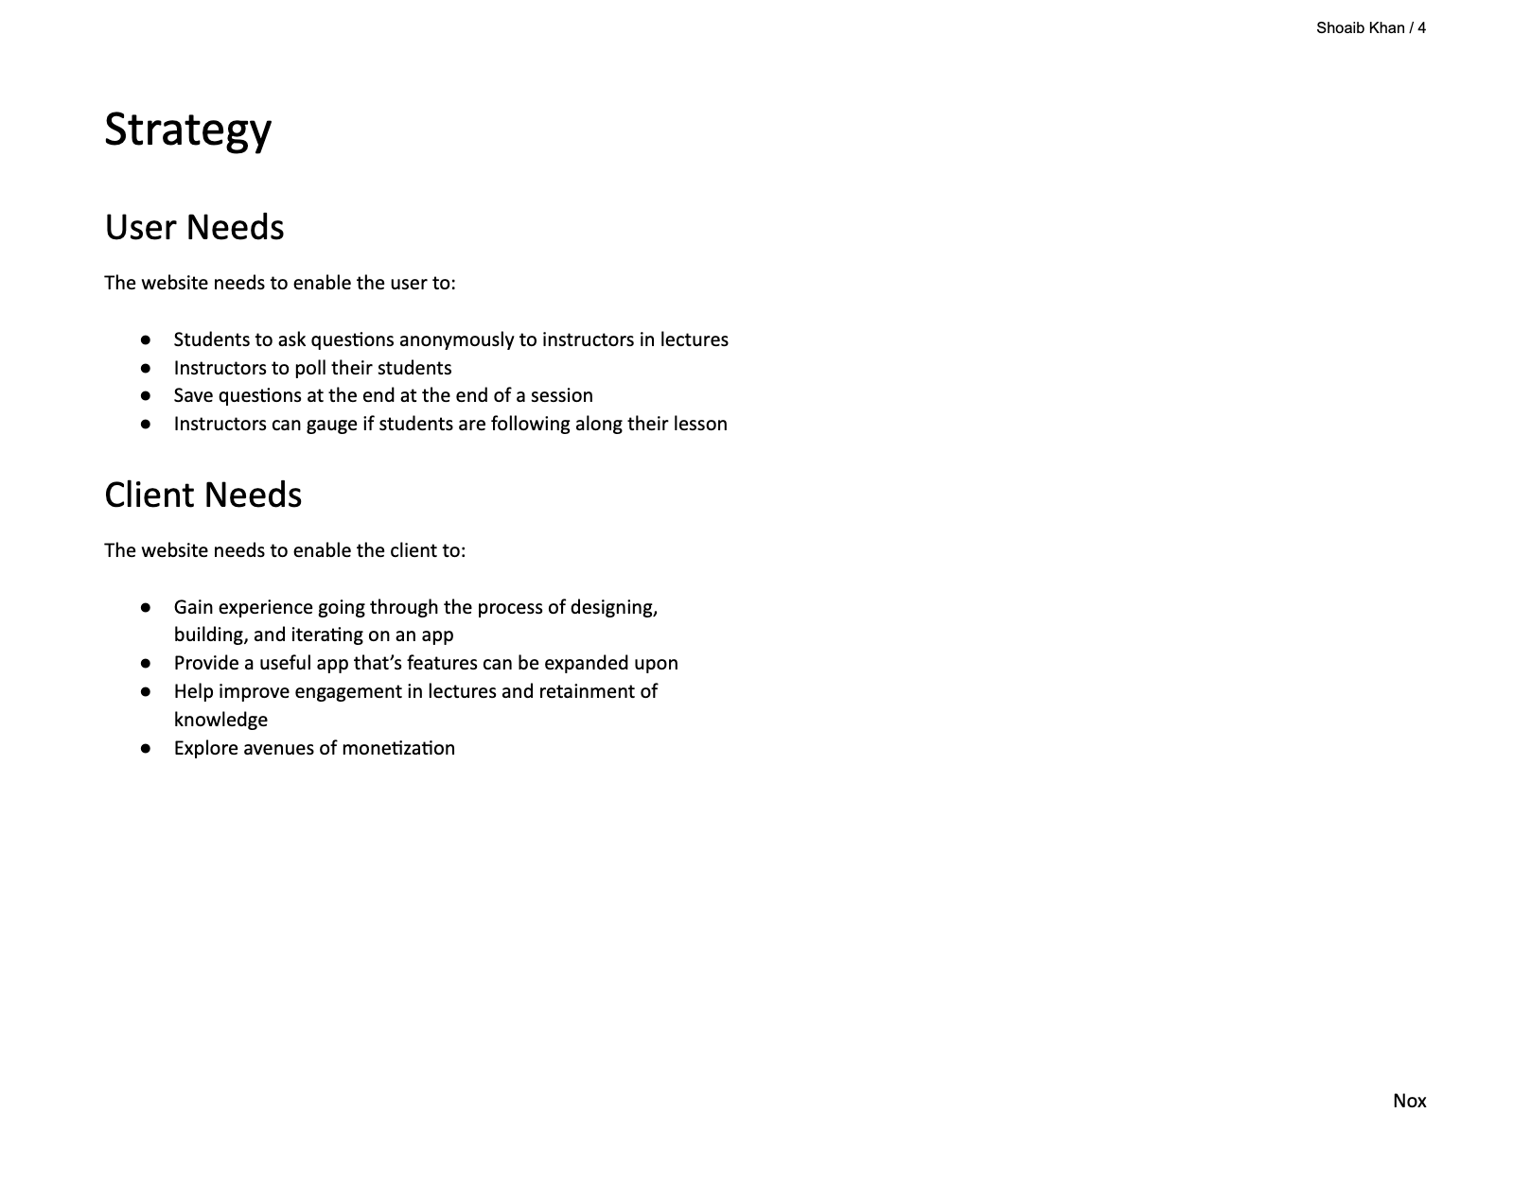
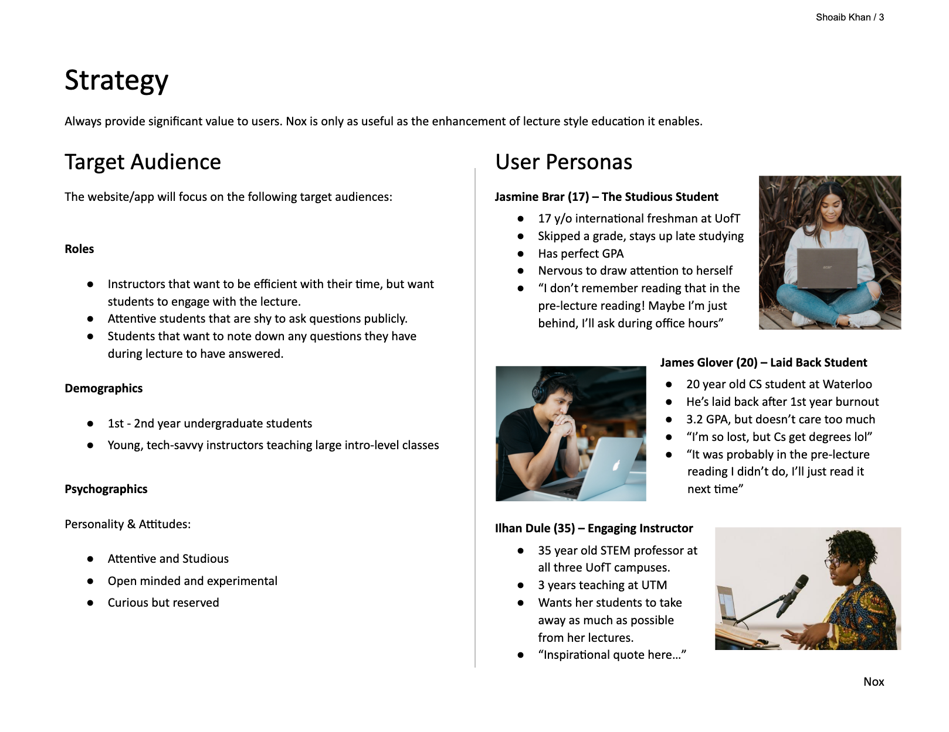
Notes:
We discussed the User and Client Needs. These remained the same as in the project brief.
The goal here is to identify the needs of both parties and when the User needs ≠ Client needs, to be able to find a balance and inform both sides on why your suggested changes are necessary.
An example of this is: A User wants to read an article in peace, but the client wants to place as many ads as possible. Here you need to find a balance of ads to content.
The target audience was narrowed down a bit more. In the case of Nox, I felt grouping by roles was the most appropriate, but included the demographics and psychographics as well.
One of your critique from the last course was regarding user personas. You mentioned that when creating personas, I should think about making them different
And to consider things such as accessibility, genders, personalities and different usecases. To address this, I created a persona for each role that I figured summed up a category of users. However, I didn’t address accessibility.
I would need to take a longer look at that to identify the different accessibility needs that would need to be addressed, and to be honest.. I’m was too lazy.

Slide 9
Week 3: Outlining Scope
Topics covered:
Creating Content and Functionality Requirements from User and Client Needs
Notes:
Onto week 3. This week focused on creating content and functionality requirements from the User and Client Needs.

Slide 10
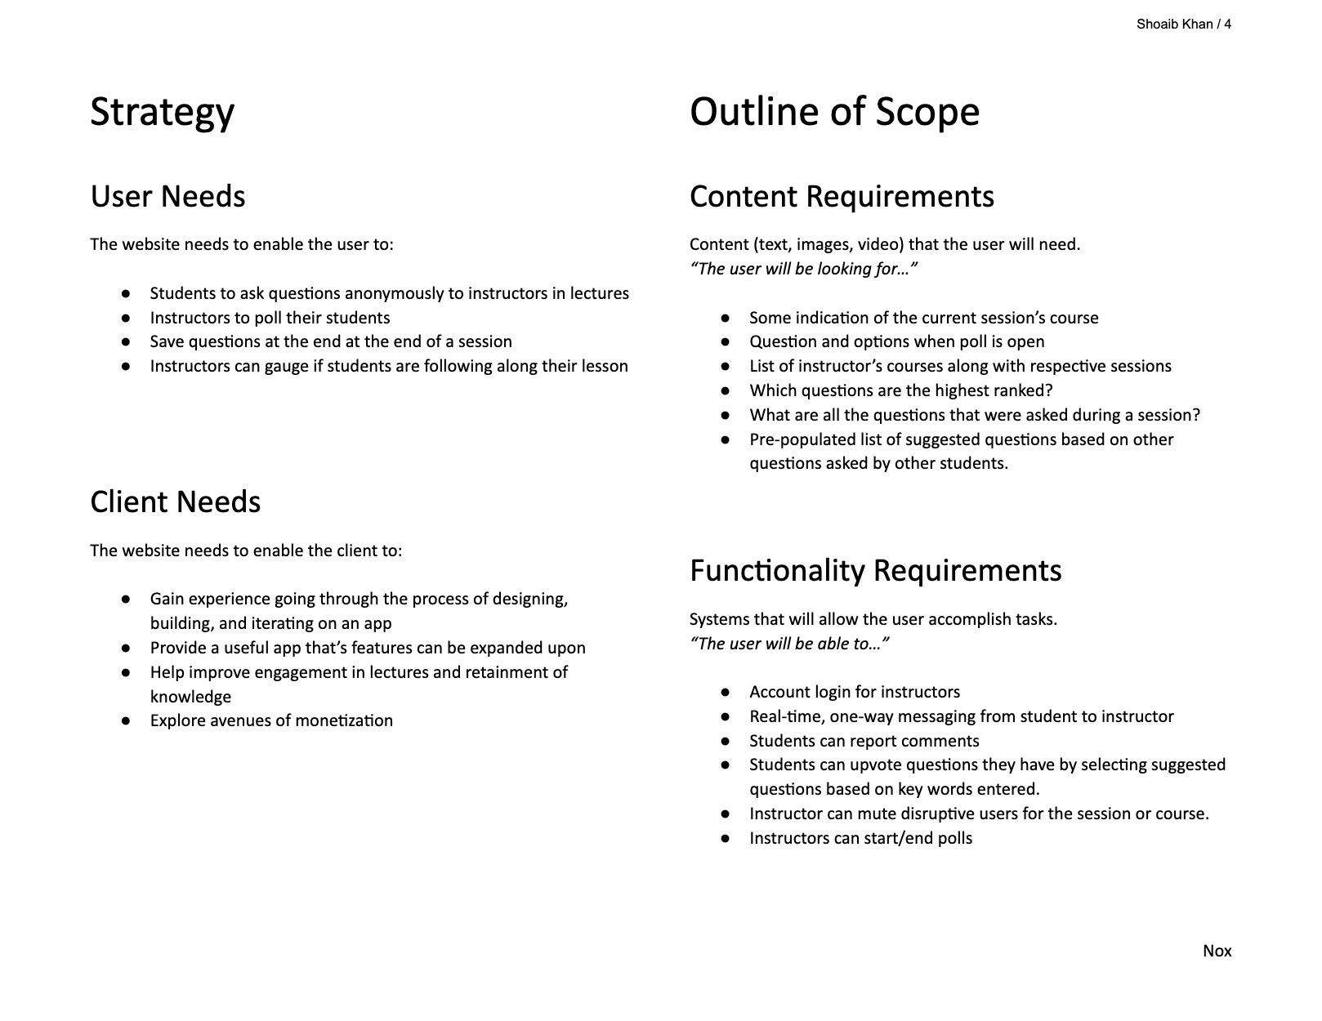
Notes:
The goal here is to create a document that contains 2 lists:
1. List all the functionality requirements to meet all the user and client needs outlined in the strategy document.
2. The same for Content requirements.
Then for every piece of content or functionality added, ask:
“Does this fulfill a user need or client need?”
“Is this feasible? (technologically, timeline wise, budget wise)”
This is again just inching towards becoming more and more concrete, but just felt painfully slow at this point.
I get we want to take it step by step, but damn.. Let’s get a move on.
I can see how this would be useful and often times necessary for large projects, but it just felt extraneous on a small project like Nox.

Slide 11
Week 4: The Sitemap
Topics covered:
Sitemaps
Overview
Concerns
Building
Elements
Notes:
This week was all about sitemaps. In the last course, we just developed a sitemap just based on the concept of a sitemap.
This time, we formalized them. We discussed the concerns, elements and building blocks of a sitemap.

Slide 12
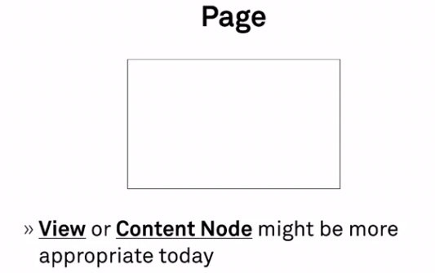
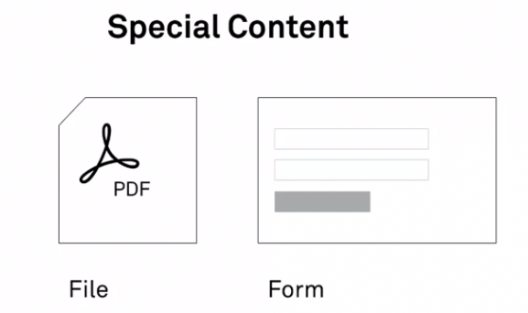
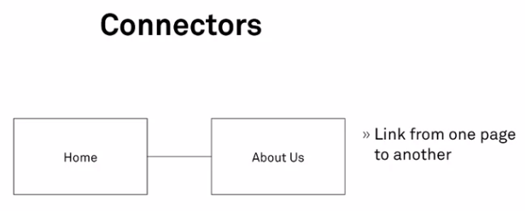
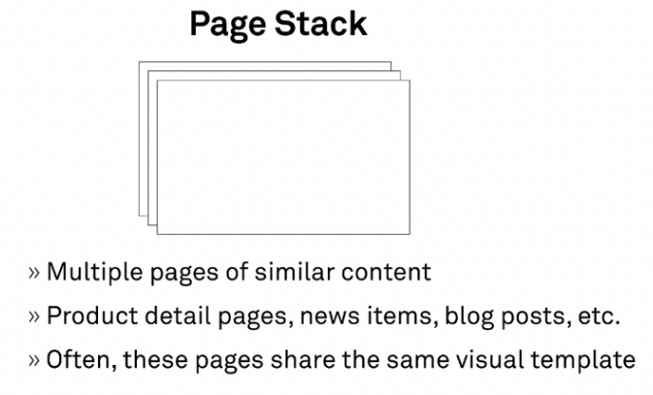
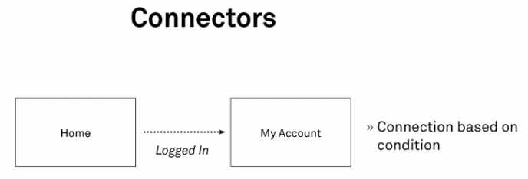
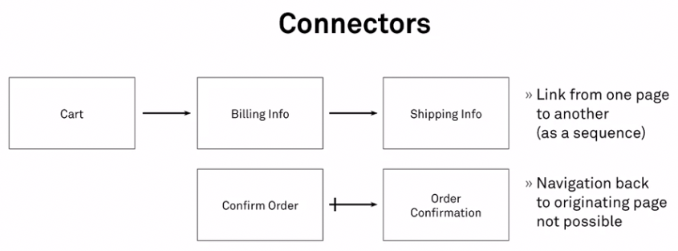
Notes:
These were some of the elements that we discussed.
Some of the concerns discussed included:
How many clicks (taps) does it take?
Best option is to have a balance between clicks and structure of info
Clicking (tapping) vs scrolling
Scrolling is often easier than clicking, that’s why ‘feeds’ are that way.
How many choices to present to the user?
Short-term memory of human can hold 7 items. +- 2 items.

Slide 13
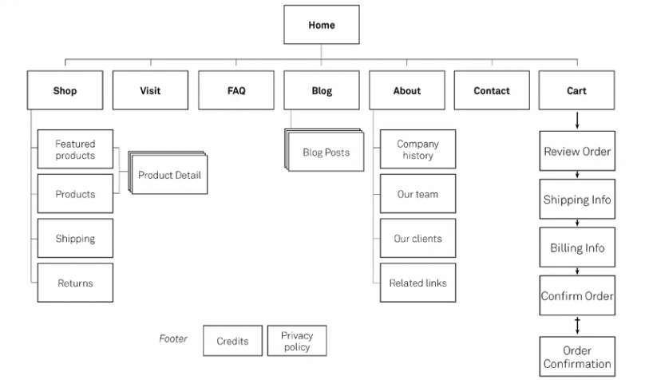
Notes:
Here is what the end product of a good sitemap should look like.

Slide 14
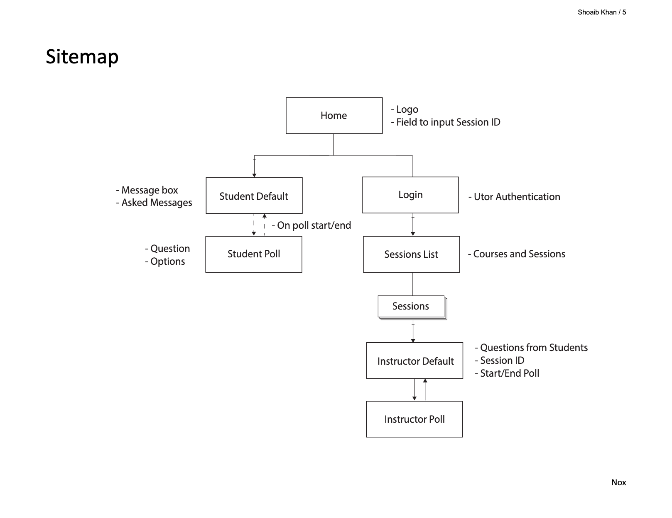
Notes:
And here it is for Nox. It looks very simplistic as the main focus of a sitemap is to layout content of a website.
Nox has very little content, rather focuses on functionality.

Slide 15

Notes:
But any who, that wraps up this course. I’m still waiting on my last assignment to be graded in order to receive the certificate. I noticed there is a large drop off in number of attendees from Course 2 to Course 3 which is probably why grading has been much slower.
Honestly, after finishing the previous course I was PUMPED for what was to come. But this course seemed quite redundant.
I felt there was too much overlap and the new material that was covered wasn’t all that new or exciting.
Granted, its likely due to coming from a CS background, we’ve already encountered these topics such as waterfall vs agile methodologies for example.
For my personal project, I’ll probably opt to skip the steps mentioned in this course.
Though I did find TreeJack to be cool and will use that in the future.
Whats next? It’s the wireframes and visual mockups highlighted earlier.

